Slide 1
Clinical Data Interchange Standards Consortium (CDISC)
SDTM (Study Data Tabulation Model)
Release Date: DD-Mmm-YYYY

Slide 2
Agenda
Overview of CDISC.
Overview of SDTM.

Slide 3
Terminology:
CDISC : Clinical Data Interchange Standards Consortium.
SDTM : Study Data Tabulation Model
ADaM : Analysis Data Model

Slide 4
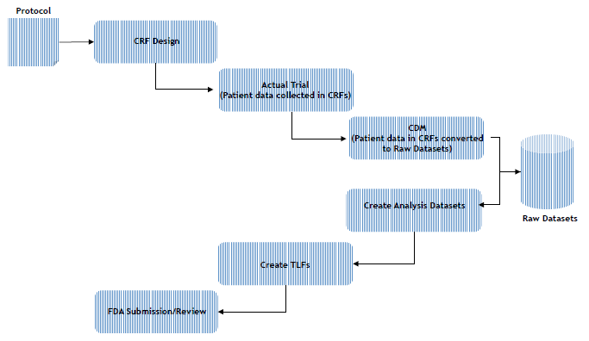
Flow of Clinical Trial Data

Slide 5
CDISC:
Development of industry standards to support the
Electronic Acquisition
Exchange
Submission and
Archiving
Of Clinical Trails data.
Development of Global, platform independent standards.
Improve data quality and accelerate product development.

Slide 6
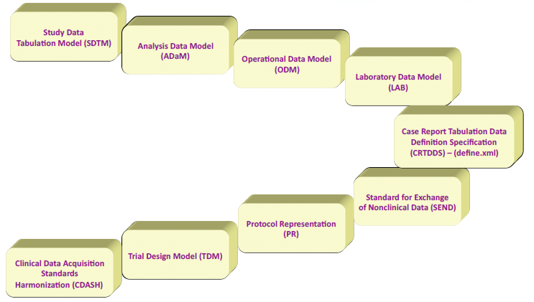
CDISC Standards

Slide 7
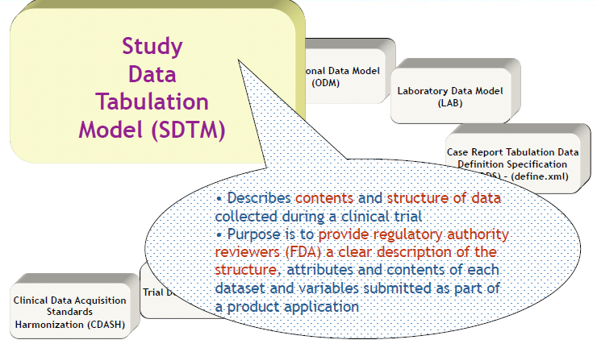
Understanding SDTM

Slide 8
SDTM:
History:
SDTM originated as the Submission Data Model (SDM).
SDTMIG V3.1.1 published in August 2005
SDTMIG V3.1.2 (Newest and Preferred)

Slide 9
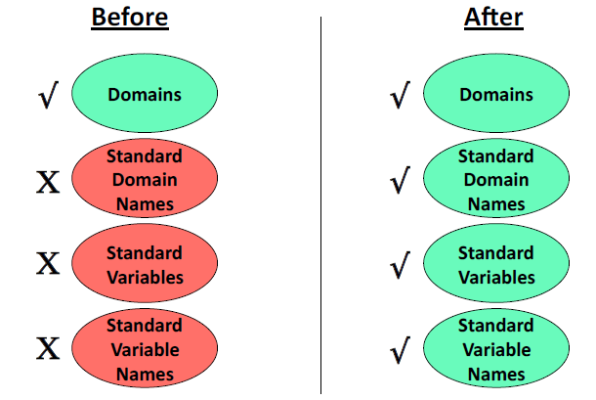
Before and After - SDTM

Slide 10
CDISC Submission Metadata Model
Seven distinct metadata attributes :
1. The Variable Name
2. A descrip7ve Variable Label, up to 40 characters
3. The data Type
4. The set of controlled terminology for the value or the presenta7on format of the variable (Controlled Terms or Format)
5. The Origin or source of each variable
6. The Role of the variable, which determines how the variable is used in the dataset.
7. Comments or other relevant informa7on about the variable or its data.

Slide 11
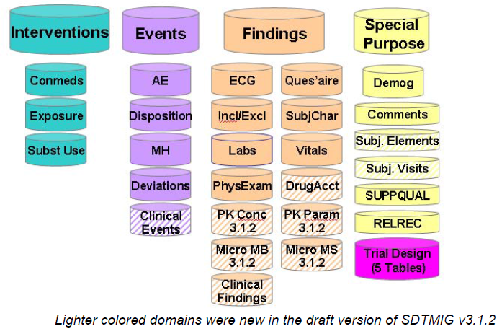
SDTM
Observation Classes

Slide 12
SDTM:
Observation Classes:
Interventions: investigational treatments, therapeutic treatments, and surgical procedures administered to the subject or animal. One record per constant dosing/treatment interval.
Events: occurrences or incidents independent of planned study evaluations occurring during the trial or prior to the trial. One record per event.
Findings: observations resulting from planned evaluations. One record per finding result or measurement.

Slide 13
SDTM:
Special Purpose Domains:
Include subject level data, do not conform to observation classes.
Examples:
DM
SE
SV
CO

Slide 14
SDTM:
Special Purpose Domains:
Supplemental Qualifiers(SUPPQUAL): Used to capture Non-Standard Data.
Related Records (RELREC): Used to describe the relation between the observations in two or more data sets.This will be created in the following situations.
Information collected about relation between concomitant medication and adverse events for an observation.
Any information which has link between multiple data sets and has a scientific rationale behind the link.

Slide 15
SDTM:
Variable Roles:
Topic Variable: Identifies the focus of the observation. There is only one per dataset.
Identifier Variables: Identify the study, the subject, the domain, and sequence number of the observation.
Timing Variables: Describe the start and end of the observation, and/or when it was collected.
Qualifier Variables: Describe the attributes and results of the observation.
Grouping Qualifiers
Result Qualifiers
Synonym Qualifiers
Record Qualifiers
Variable Qualifiers

Slide 16
SDTM:
Grouping Qualifiers: Used to group together the collection of observations.
Examples: include --CAT and --SCAT.
Result Qualifiers: Describes the specific results associated with topic variable in findings.
Examples: include --ORRES, --STRESC, --STRESN.
Synonym Qualifiers: Describe an alternative name for a particular variable in an observation.
Examples: include --MODIFY and –DECOD.

Slide 17
SDTM:
Record Qualifiers: Additional attributes of the observation record as a whole.
Examples: --BLFL, --POS and --LOC, --SPEC, --LOT, --NAM
Variable Qualifiers: Further describes the value of an observation in a record.
Examples:
--ORRESU, --ORNRHI, and –ORNRLO are Variable qualifiers for ORRES.
--DOSU and –DOSFRM are Variable qualifiers for DOSE.

Slide 18
SDTM:
Core Variables:
Required : This variable must be present in the data set and cannot be null for any record.
Expected : This variable must be present in the data set and can have a null value.
Permissible : This variable can be included in the data set appropriately and when data is collected. If all records are null values then this type of variable can be dropped.

Slide 19
Reference
SDTM IG 3.1.2V
www.cdisc.org

Slide 20


Slide 21

Thank You!
For any feedback/comment/clarification please contact us at PALS@tcs.com
Copyright © 2012 Tata Consultancy Services Limited
V 00.00

Slide 22
DOCUMENT RELEASE NOTICE
This XXXX, Version aa.bb, is released for use in Tata Consultancy Services (TCS) with effect from DDMMYY
This Training Material is subject to TCS Document Control Procedure. TCS reserves the right to make additions, modifications or alterations to the existing content or release a newer version of this document.
Softcopy of the latest version of the document is available in the ABCDEFG
Comments suggestions or queries should be addressed to PALS@tcs.com.
Prepared by:
Text
Role
Date:
Text
Reviewed by:
Text
Role
Date:
Text
Approved by:
Text
Role
Date:
Text
Authorized by:
Text
Role
Date:
Text
Effective Date: DD-Mmm-YYYY

Slide 23
Change/Revision History
Revision Description | Slide No. | Rationale for the Change | Change type (Add/Modify/Delete) | Modified By | Date Modified (DD-Mmm-YYYY)
Initial Release | NA | NA | NA | NA | Na

